Slide 1
HandwrittenDigits GAN:
DONE BY :
kiruthika.p btech/it 3rd yeaR
210921205027
kiruthika3204@gmail.com
LOYOLA INSTITUTE OF TECHNOLOGY
PALANCHUR,CHENNAI-123

Slide 2
OUTLINE :
Problem Statement
Proposed System/Solution
System Development Approach
Algorithm and Deployment
Result
Conclusion
References

Slide 3
PROBLEM STATEMENT:
Design and implement a Generative Adversarial Network(GAN) to generate realistic handwritten digits resembling those from the MNIST dataset. The objective is to train a GAN model using” Tensor Flow and Keras” to generate new digit images that closely resemble the distribution of digits in the MNIST dataset.
The model should be capable of generating diverse and visually convincing digit images, demonstrating the effectiveness of the GAN architecture for image generation tasks.

Slide 4
PROBLEM STATEMENT:
The proposed system aims to utilize a GAN architecture to generate realistic handwritten digits similar to those found in the MNIST dataset. The system consists of the following components:
1. Generator Model: A neural network model designed to generate synthetic digit images. The generator takes random noise as input and outputs images that resemble handwritten digits.
2.Discriminator Model : Another neural network model responsible for distinguishing between real and generated images. The discriminator learns to classify images as either real (from the MNIST dataset) or fake (generated by the generator).

Slide 5
PROBLEM STATEMENT:
3 .GAN Model : The GAN model combines the generator and discriminator. During training, the generator aims to produce images that can fool the discriminator into classifying them as real. Simultaneously, the discriminator learns to distinguish between real and generated images accurately.
4.TrainingProcess : The system iteratively trains the generator and discriminator models in an adversarial manner. The generator improves its ability to generate realistic images by receiving feedback from the discriminator, while the discriminator enhances its ability to differentiate between real and fake images.
5.EvaluationandTesting : The trained GAN model is evaluated based on its ability to generate high-quality digit images that closely resemble those in the

Slide 6
PROBLEM STATEMENT:
MNIST dataset. The system may also perform qualitative and quantitative assessments to measure the model's performance and compare generated images against real MNIST digits.
Overall, the proposed system leverages the power of GANs to generate synthetic digit images, offering a novel approach to data generation tasks in the context of computer vision and image processing.

Slide 7
SYSTEM APPROACH
HARDWARE REQUIREMENT :
Multi-core CPU for preprocessing and computationa ltasks.
GPU with CUDA support for accelerated training, preferably NVIDIA GeForce GTX or RTX series.
Adequate VRAM to accommodate model and batch sizes, especially for larger image sizes.
Sufficient storage space for dataset, model checkpoints, and logs. Sufficient system RAM for handling data loading and training operations efficiently.
Ensure PSU can handle power demands, especially for high-end GPUs.

Slide 8
SYSTEM APPROACH
SOFTWARE REQUIREMENT :
Google Account:Required to sign into Google Colab.
Web Browser: Access toa modern web browser like GoogleChrome, Mozilla Firefox, Safari, or Microsoft Edge.
Python Environment: Provided by Google Colab, allowing you to write and execute Python code.
Libraries: Commonly pre-installed libraries include TensorFlow, Keras, NumPy ,and Matplotlib.
Optional GPU Access: Google Colab offers optional access to GPUs for accelerated training, which can be enabled in the note book settings.

Slide 9
ALGORITHM:
Here's a high-level algorithm for a Handwritten Digits GAN:
Import Libraries : Import TensorFlow, Keras, NumPy, and Matplotlib for building and training the GAN model.
Define Generator Model : Create a function to build the generator model using a sequential architecture with dense layers and reshape for generating images. Define
Discriminator Model : Create a function to build the discriminator model using a sequential architecture with dense layers for binary classification.
Define GAN Model : Create a function to combine the generator and discriminator into a GAN model. Set the discriminator to not trainable during GAN training.

Slide 10
ALGORITHM:
Load and Preprocess MNIST DaTa set : Load the MNIST dataset and preprocess it by scaling pixel values to the range [0, 1].
Build and Compile Discriminator : Build the discriminator model and compile it with an optimizer and loss function.
Build and Compile Generator : Build the generator model and compile it with an optimizer and loss function.
Build and Compile GAN : Build the GAN model by combining the generator and discriminator. Compile the GAN with an optimizer and loss function.

Slide 11
ALGORITHM:
Training Loop : Iterate over a fixed number of epochs:
Evaluation and Visualization : Evaluate the trained GAN model and visualize generated images to assess the quality of digit generation.

Slide 12
DEPLOYMENT:
Model Serialization : Save the trained generator model to disk using HDF5orSavedModel format.
Web Application Deployment : Build a web app with Flask or Django, load the model, expose an endpoint for image generation, and return generated images.
Cloud Deployment : Deploy the model on GCP, AWS ,or Azure ,expose endpoints over HTTP(S) or Grpc ,and secure access. API Deployment: Serve the model as a RESTful org RPC API using TensorFlow Serving or ONNX Runtime, and integrate with other systems.

Slide 13
DEPLOYMENT:
Monitoring and Maintenance : Implement monitoring, logging, and alerting mechanisms, and perform regular maintenance and updates.
Documentation and User Support : Provide user-friendly documentation and support channels for users.
By following these steps, you can deploy your GAN model for MNIST digit generation effectively in various environments for real-world usage

Slide 14
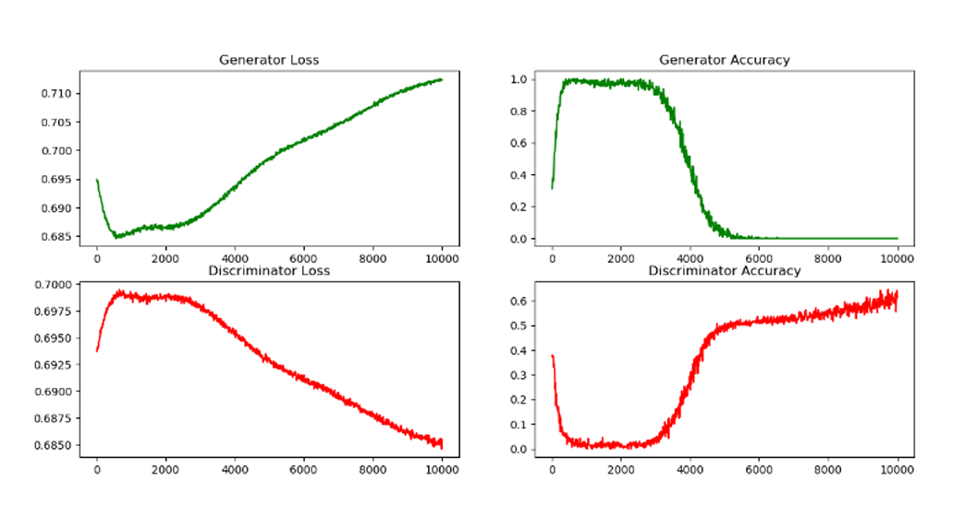
RESULT:

Slide 15
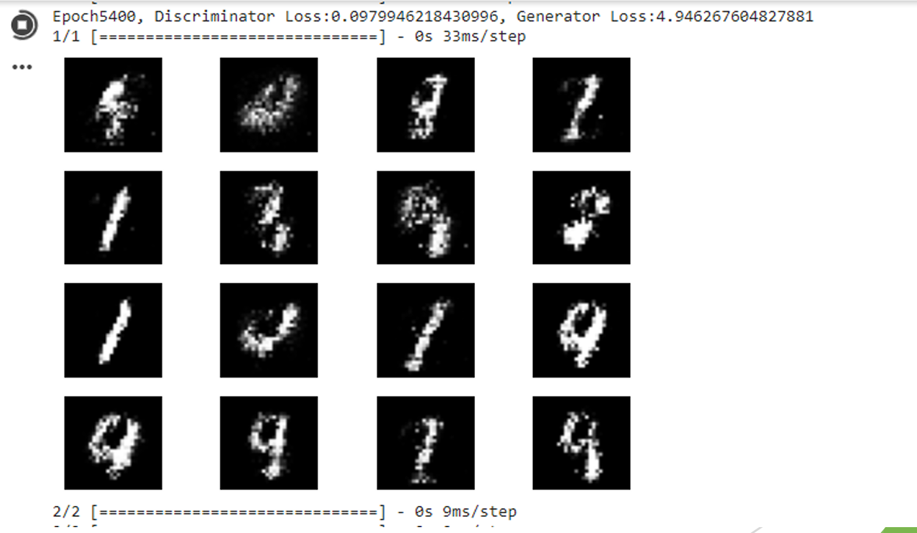
RESULT:

Slide 16
CONCLUSION:
This project achieved successful implementation and training of a Generative Adversarial Network (GAN) for generating MNIST digit images using “ Tensor Flow and Keras” .
Deployment options such as web apps ,cloudservices, and APIs were explored, highlighting the GAN’s potential for real-world applications. Ongoing optimization efforts can further enhance model usability and performance, promising broader impact in diverse domains.

Slide 17
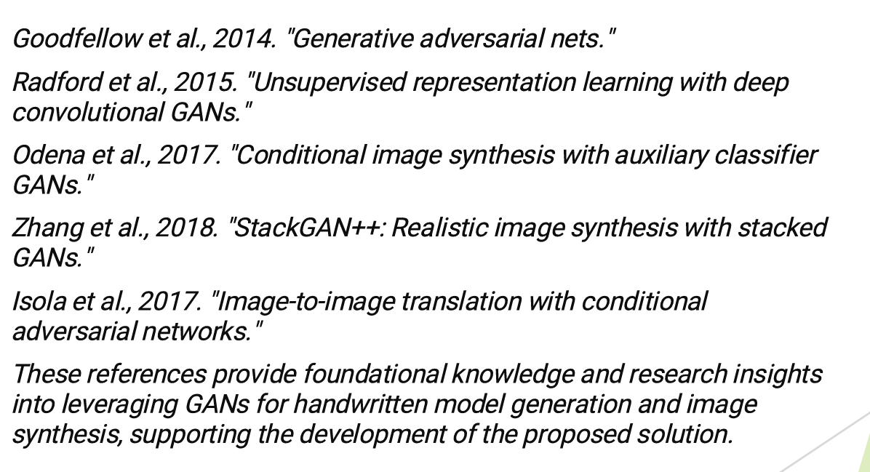
REFERENCES:

